Slide 1


ARBA MINCH UNIVERSITY
INTERNSHIP PRESENTATION
Development of the AMU Dedicated Store & Resource Management System
PREPARED BY
Yonas Girma
Practical Attachment Intern
HOSTING ORGANIZATION
Arba Minch University (AMU)
ICT Directorate (ICTD)

Slide 2
Transitioning AMU's Store Operations to a Centralized Platform
45
Prior Legacy State
Prior to this system, store inventory and departmental requisition operations at AMU relied on decentralized, paper-based bookkeeping.
This manual approach made tracking stock accurately challenging, slowed down request processing across campuses, and required substantial manual effort when compiling paper records for audits.
Working-Day Practical Attachment
Timeline
July 2 – September 2, 2026
Host Institution
Arba Minch University ICT Directorate (ICTD)
Supervision
Mr. Chirotaw Kentib,
Application Development Team Leader
Primary Challenge Objective
Design and build a custom web application from the ground up to replace manual workflows by digitizing item cataloging with real-time, dynamically computed stock balances and implementing a structured requisition-to-issuance workflow.
Replacing physical paper routing with a centralized digital platform enforces institutional accountability and auditability while preserving the operational speed required across departments.

Slide 3

System Architecture
The system leverages a modern, containerized layered client-server architecture using NestJS, React, and PostgreSQL, orchestrated for development and production environments.
Backend Framework
NestJS 10.4.0 modular framework with dependency injection.
Features distinct modules for authentication, user management, inventory, requests, and reporting.
Database & Persistence
PostgreSQL 16 relational database.
Accessed through Prisma ORM 5.19.0 for type-safe database queries and automated schema migrations.
Frontend Client
React 18 + Vite SPA typed with TypeScript.
Utilizes Tailwind CSS for utility-first styling and TanStack Query for server-state caching and async data fetching.
Infrastructure & Proxy
Docker & Compose containerization.
Orchestrates the NestJS API, PostgreSQL database, Vite frontend, and Nginx reverse proxy across dev and prod configurations.

Slide 4
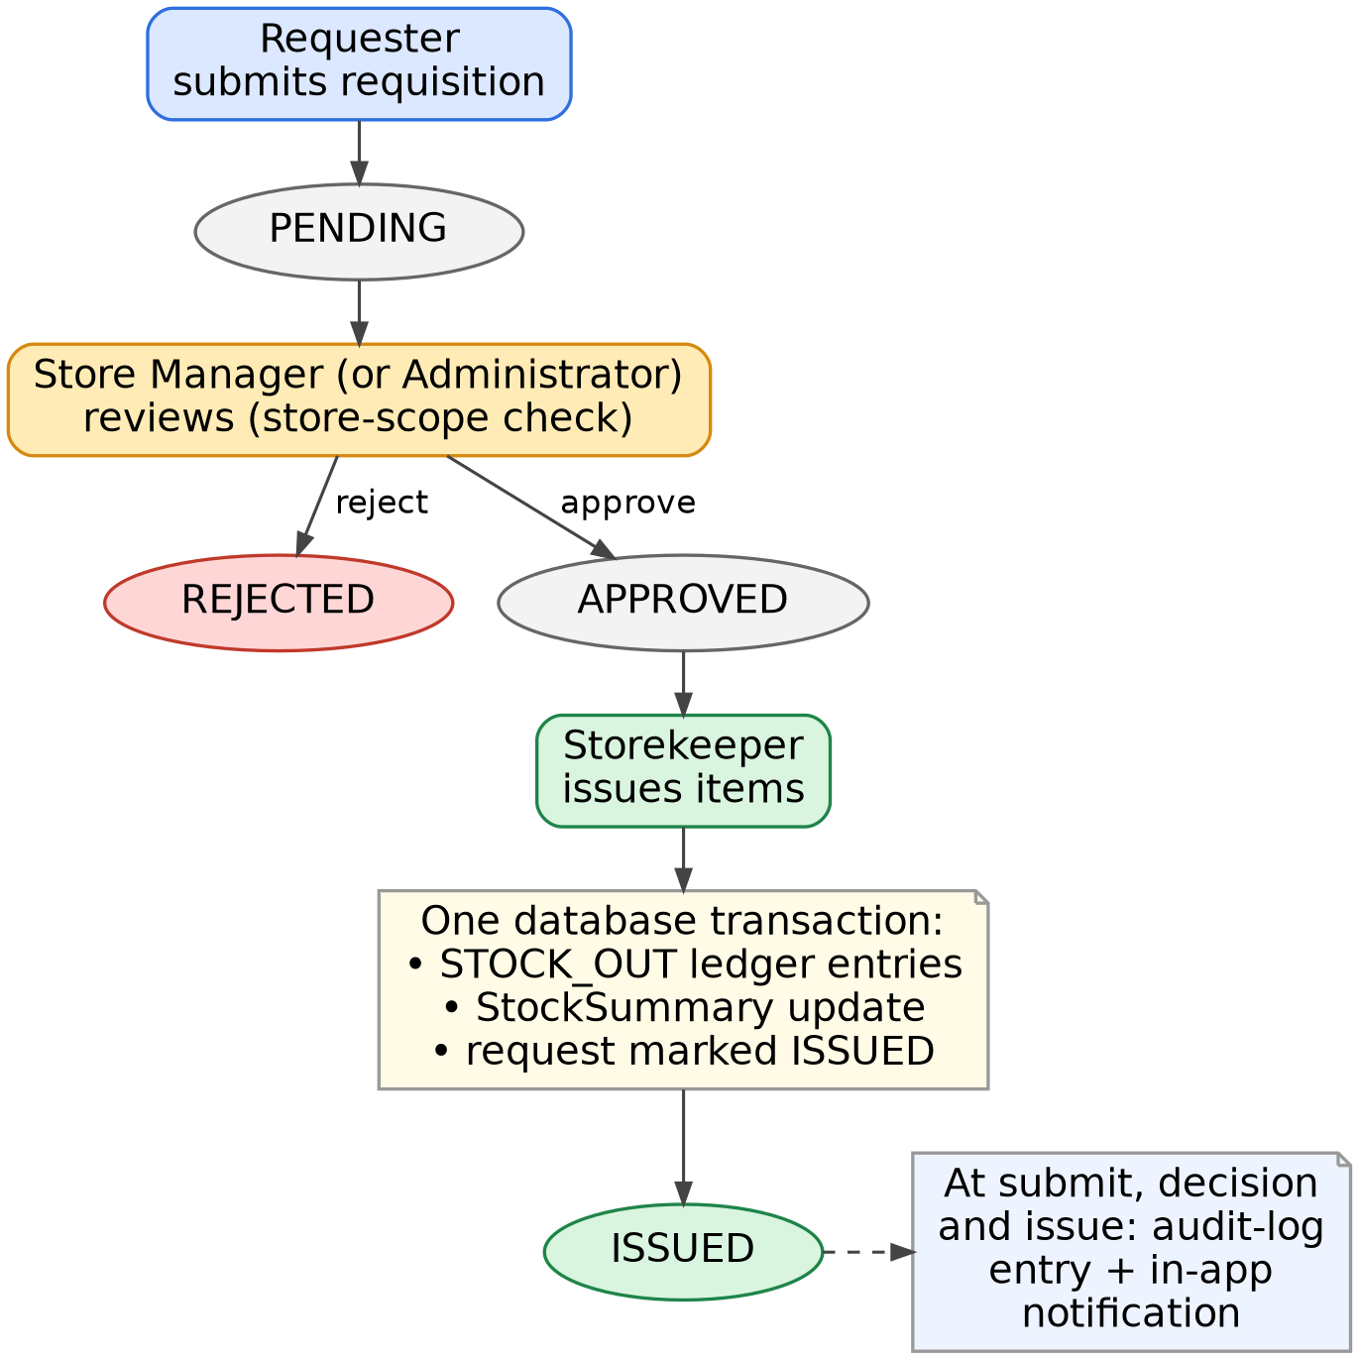
Requisition Workflow & Operational Accountability
Requisition Path & Role-Based Approval
Academic staff (Requester) submits a request, reviewed by Store Manager. Once approved, Storekeeper issues items.
Atomic Database Transaction
Issuance executes within a single Prisma transaction to maintain absolute data integrity:
Verifies stock availability
Writes STOCK_OUT ledger entries
Decreases StockSummary balance & marks request ISSUED
Direct Operations & Typed Ledger
Handles supplier stock-in, direct stock-outs, returns, adjustments, and transfers. Every operation writes a typed ledger entry, preventing balance discrepancies.

Slide 5
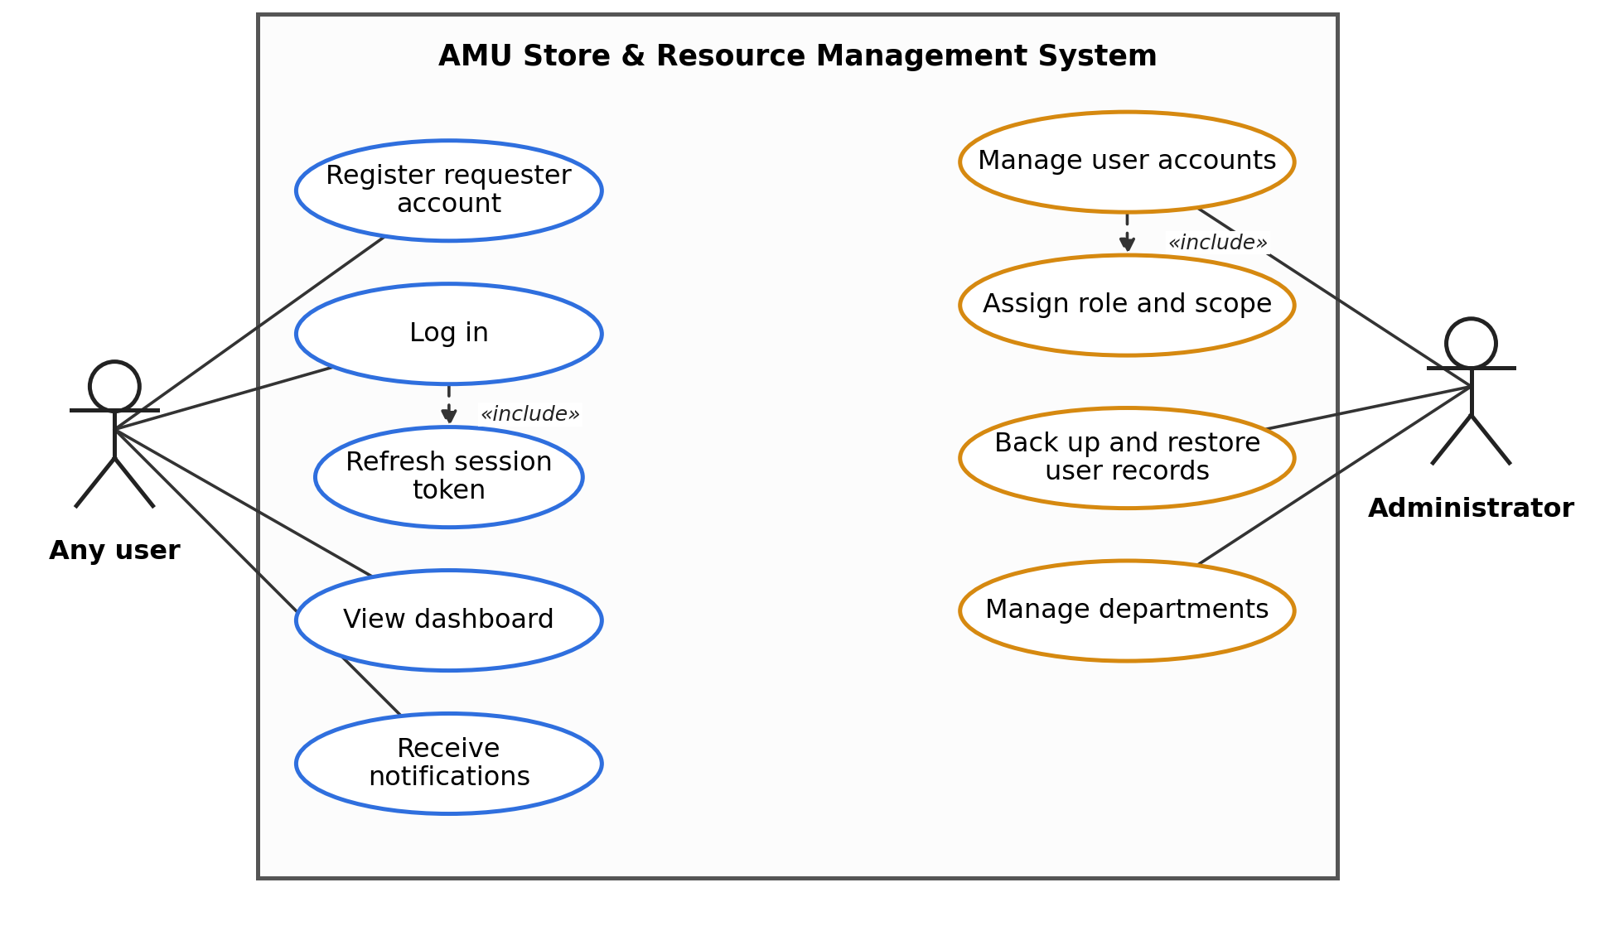
Security & Access Control Architecture
Stateless JWT Auth
Authentication is stateless, utilizing JSON Web Tokens (JWT) to issue both access and refresh tokens for secure session maintenance.
RBAC & Scoped Controls
Roles are constrained by explicit scope values: global, organizational, or store-level. A Store Manager's scope is strictly verified prior to requisition approval.
Five Distinct Roles
Users are assigned one of five institutional roles: Requester, Store Manager, Storekeeper, Internal Auditor, or Administrator.
Append-Only Audit Log
Key operations (stock actions, requisition decisions, user modifications) automatically generate append-only entries, preserving a historical record for auditors.
Institutional Access Model
The platform's security and access control model is designed to reflect AMU's institutional structure, bridging external requesters and administrative governance through verified scopes.

Slide 6
Key Challenges & Strategic Solutions
Technical Challenges
Collaborative Mentorship
Adapting to the NestJS and Prisma ecosystem, alongside TypeScript's strict typing, required overcoming a steep learning curve that extended beyond standard coursework.
A significant technical challenge was managing concurrency risks to keep received, issued, and balance figures consistent.
I assumed an informal leadership role within the intern team. Because several teammates had limited prior exposure to professional development practices, I guided them through Git and GitHub workflows, including branching, committing, pull requests, and peer code review.
This required balancing patient mentorship and clear communication of foundational concepts without slowing the team's overall progress or compromising code quality.
Technical Mitigation Strategy
Concurrency risks were mitigated by wrapping each stock movement and its corresponding stock-summary update inside a single Prisma database transaction.

Slide 7
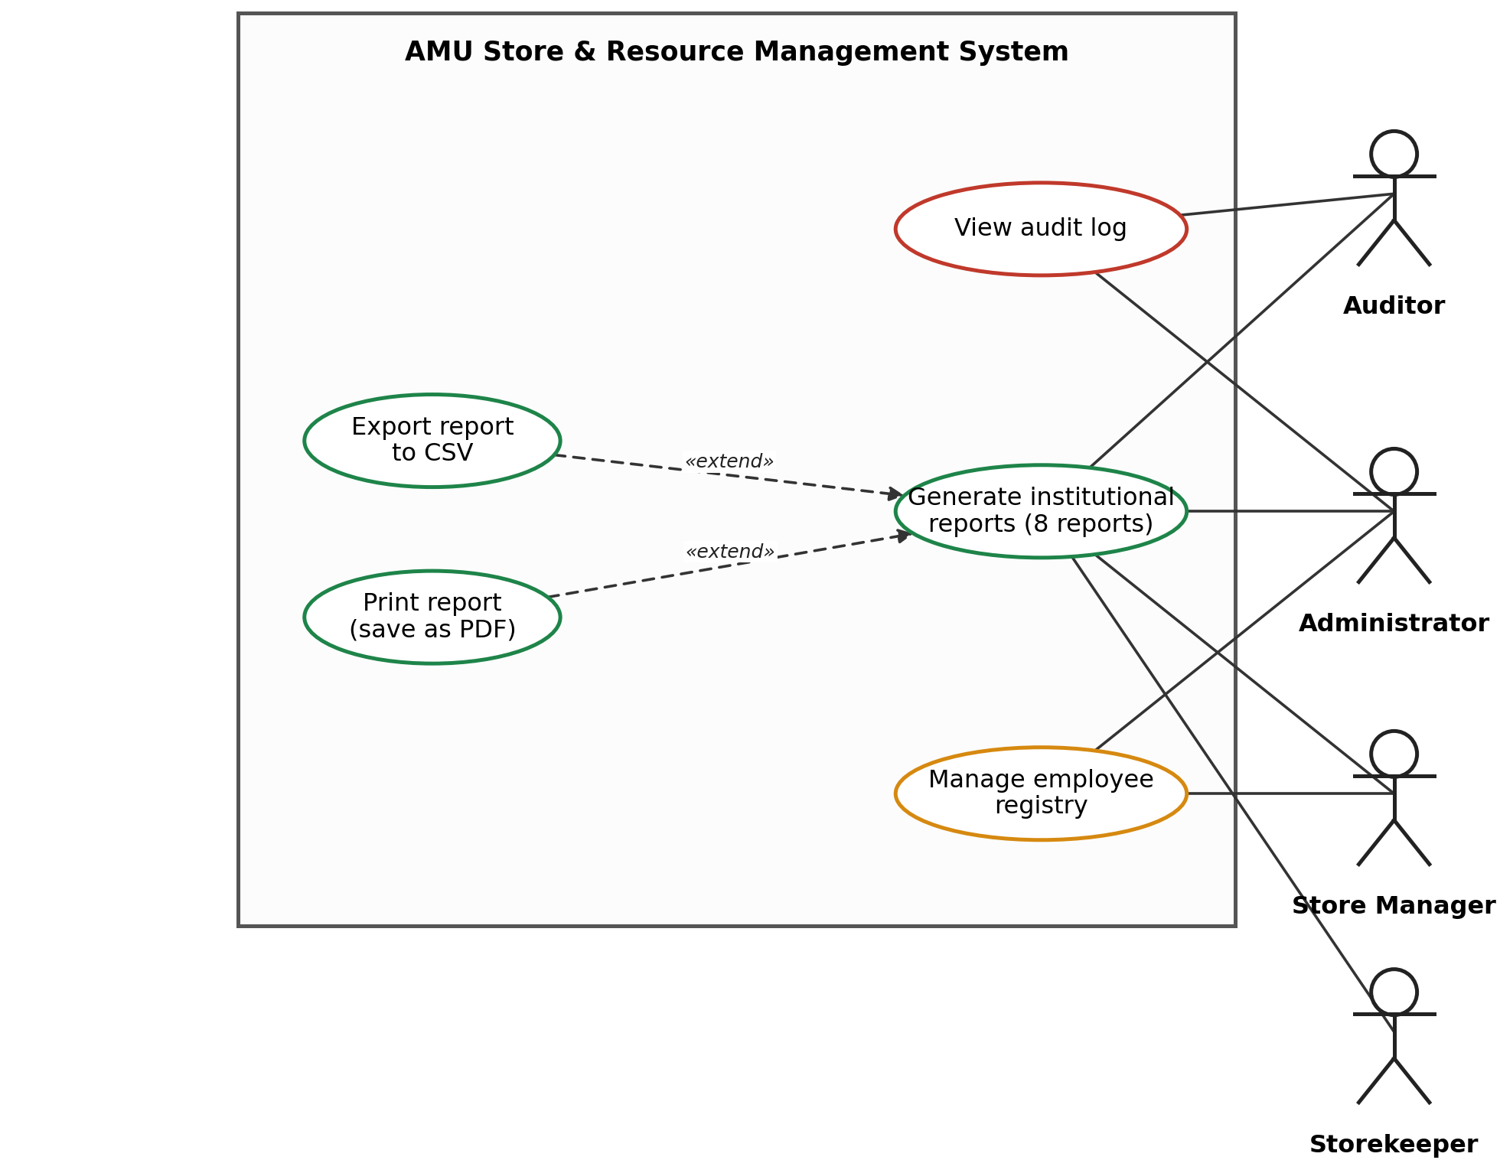
Digitized Store Operations Prototype
Primary Internship Achievement
Fully working prototype (repository commit 01b0e84) automating registration, tracking, and requisition workflows for AMU institutional stores.
Comprehensive Material Catalog: Features categories, units of measure, minimum-stock thresholds, and barcode/QR identifiers.
Reports & Analytics Module: Generates 8 automated institutional reports for university compliance (e.g., Overall Inventory Status, Stock Receiving Ledger, Departmental Requisition Log).
Export & Document Generation
Export reports directly to CSV for Excel integration or print as PDFs straight from the browser.
Dashboard & Alerts: Provides real-time in-app notifications for managers and storekeepers regarding new requests, decisions, and low-stock alerts.
Figure 1: Use Case Diagram — AMU Store & Resource Management System

Slide 8
Recommendations for Institutional Adoption
1. Strategic: Handover & Pilot
Establish a formal codebase handover process and assign permanent maintainers within ICTD.
Roll out a phased pilot within the ICTD store before expanding to other university departments.
2. Strategic: Training & Migration
Conduct structured training programs for staff to ensure smooth adoption.
Develop and execute a formal plan for migrating existing paper records into the digital system.
3. Technical: Concurrency Hardening
Harden direct stock-out operations against concurrent usage.
Perform balance checks entirely inside DB transactions (e.g., via row-level locking).
4. Technical: Infrastructure & Services
Wire scaffolded Nodemailer & BullMQ for scheduled email alerts.
Implement automated full-database backups.
Replace browser-based exports with server-side Excel & PDF generation.

